Slide 1
Visualization Recreation
Elias Hairatidis, Samariddin Zarifov, Sofia Huang

Slide 2
Background
We chose to study The University of Michigan's football team, the current 2024 College Football National Champions to learn what got them to their historic victory
Football is an analytical sport; coaches use many metrics in deciding who makes the cut and in creating a cohesive football team
To determine what created their winning culture for this year's triumphant team, we looked at their composure of players from 1990-2022

Slide 3
Data
The data for this visualization is from the University of Michigan's football team
Each row is a different player and contains data such as their position, class year, rating (stars), draft group, and other statistics
The data includes both past and present players, for a total of 378 players

Slide 4
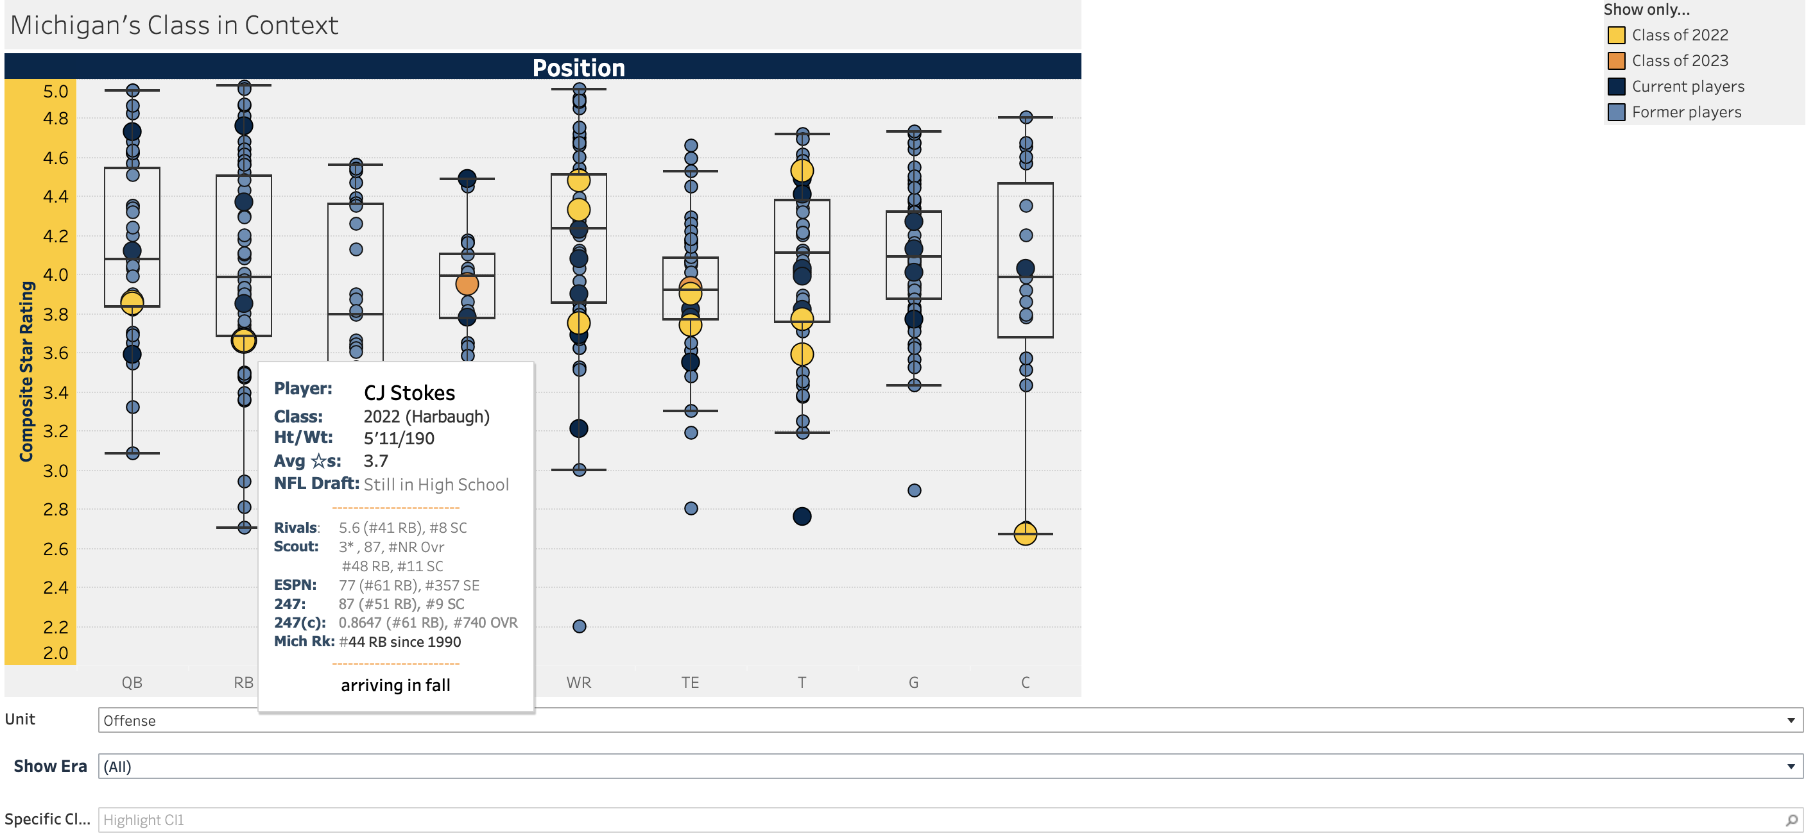
Original Visualization
https://public.tableau.com/app/profile/seth.fisher/viz/2018RecruitingData/2022ClassinContext

Slide 5
Original Visualization
Seth Fisher, the original creator, focused his work on creating ease of access to the data
The response variable is average star rating (1-5)
With simple filters, the reader could easily look up current players verse past players, offense verse defense and much more
The use of boxplots helps the reader see the distribution, while considering outliers
The most useful aspect of the original visualization are the various filters that allow the user to pick what data they want to see.
The cards that appear when the user hovers over a data point to show more information about the player is also useful and a good way to display more information without overcrowding the visual.

Slide 6
Recreation
Getting data from the visualisation
Which has been confusing and one of the most difficult parts
Which dimensions or measures should be put in column and row while which should be used in as marks
Which should be chosen for filtering and highlighting
Filtering and highlighting as intended
Using tooltip for making each data point show the information about itself
Formatting, editing sizes, changing colors, naming the sheets for a better visualisation
Notes:
The first step was to observe the data and see which columns were the main ones used in the visual (Average Star Rating and Position), then create a basic box and whisker plot.
Next, the column used to make the points different colors (Past/Present/Future) was identified and a card that serves as a legend and a filter was created.
The tooltip was created next. All the columns used to display the players' information was found and added. The style of the tooltip (font, text size, etc.) was changed to match the original.
Next, the highlighters at the bottom of the plot were created to let the user highlight the data they want to see.
Finally, the colors, title, and axes labels were modified to match the original.
**A technical challenge we faced was not having access to all of the data used to create the visualization. Only the offense data was available so we could not create the plots that used the defensive positions.

